Slide 1
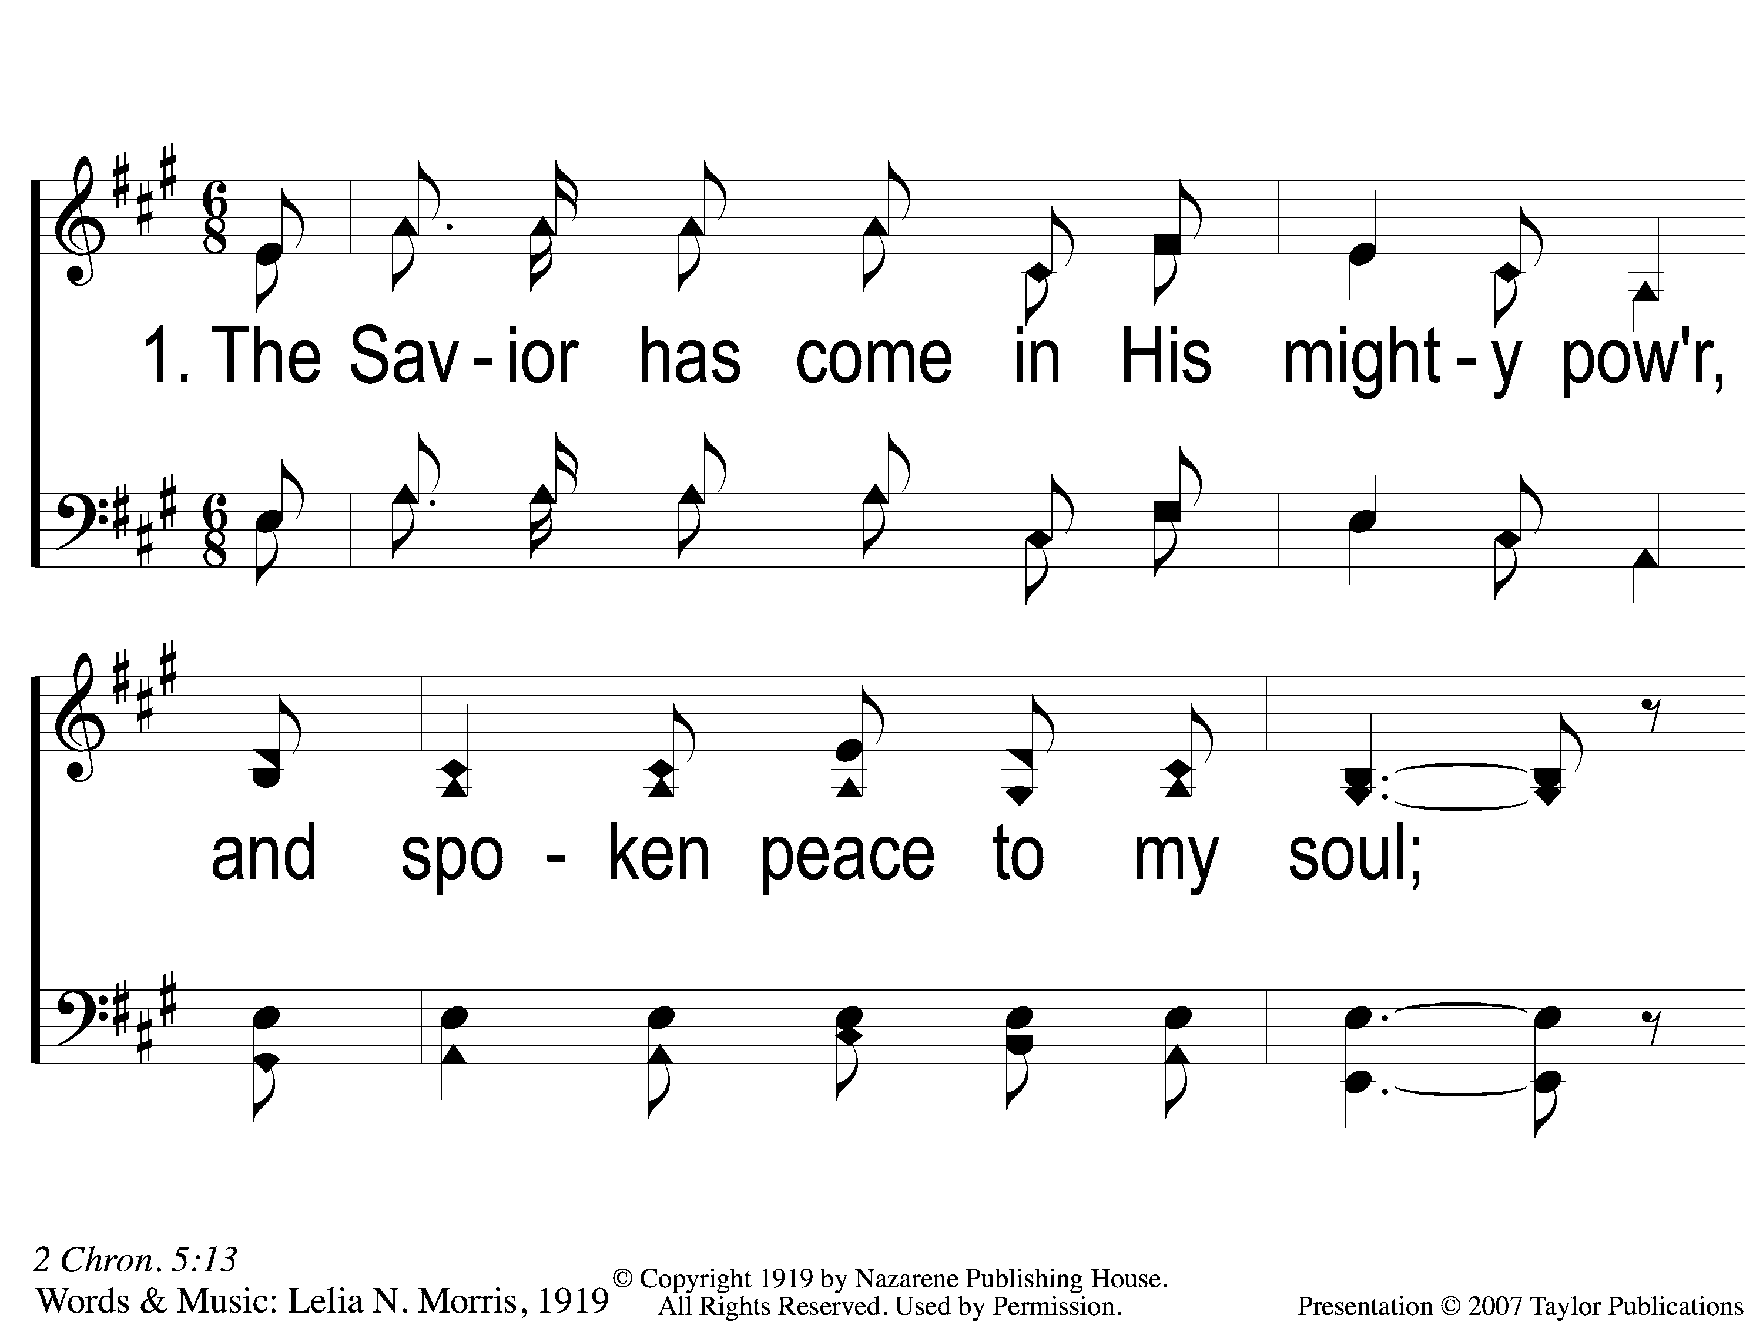
1-1 Tis Marvelous
Tis Marvelous
160

Slide 2
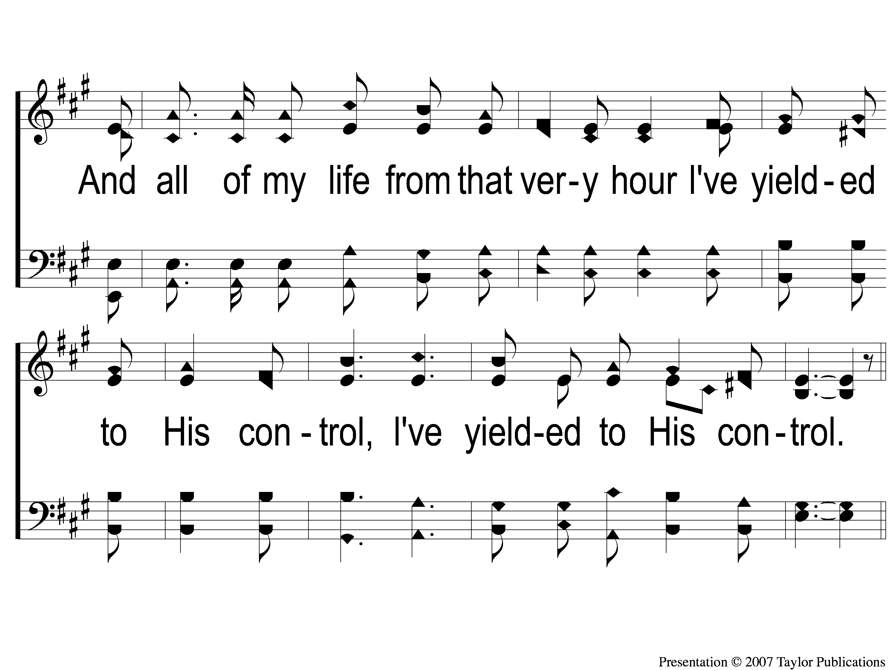
1-2 Tis Marvelous
Tis Marvelous
160

Slide 3
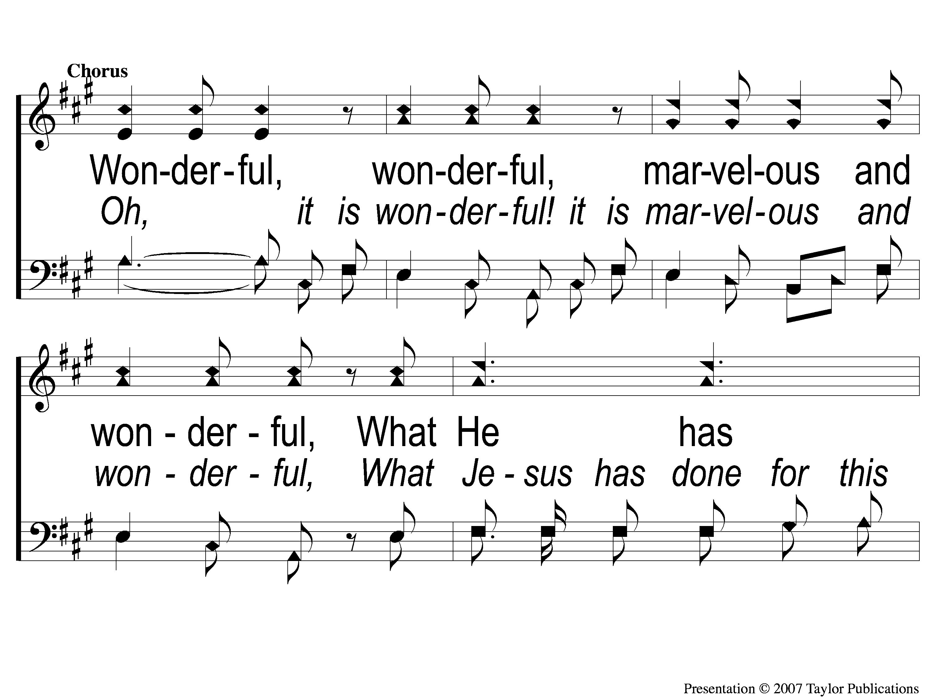
C-1 Tis Marvelous
Tis Marvelous
160

Slide 4
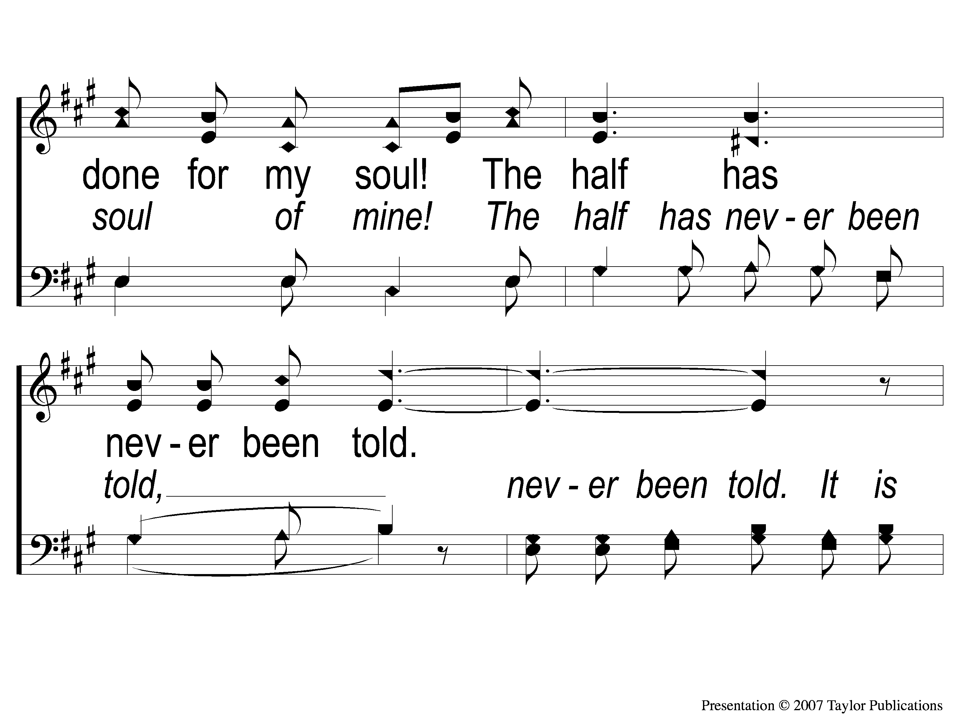
C-2 Tis Marvelous
Tis Marvelous
160

Slide 5
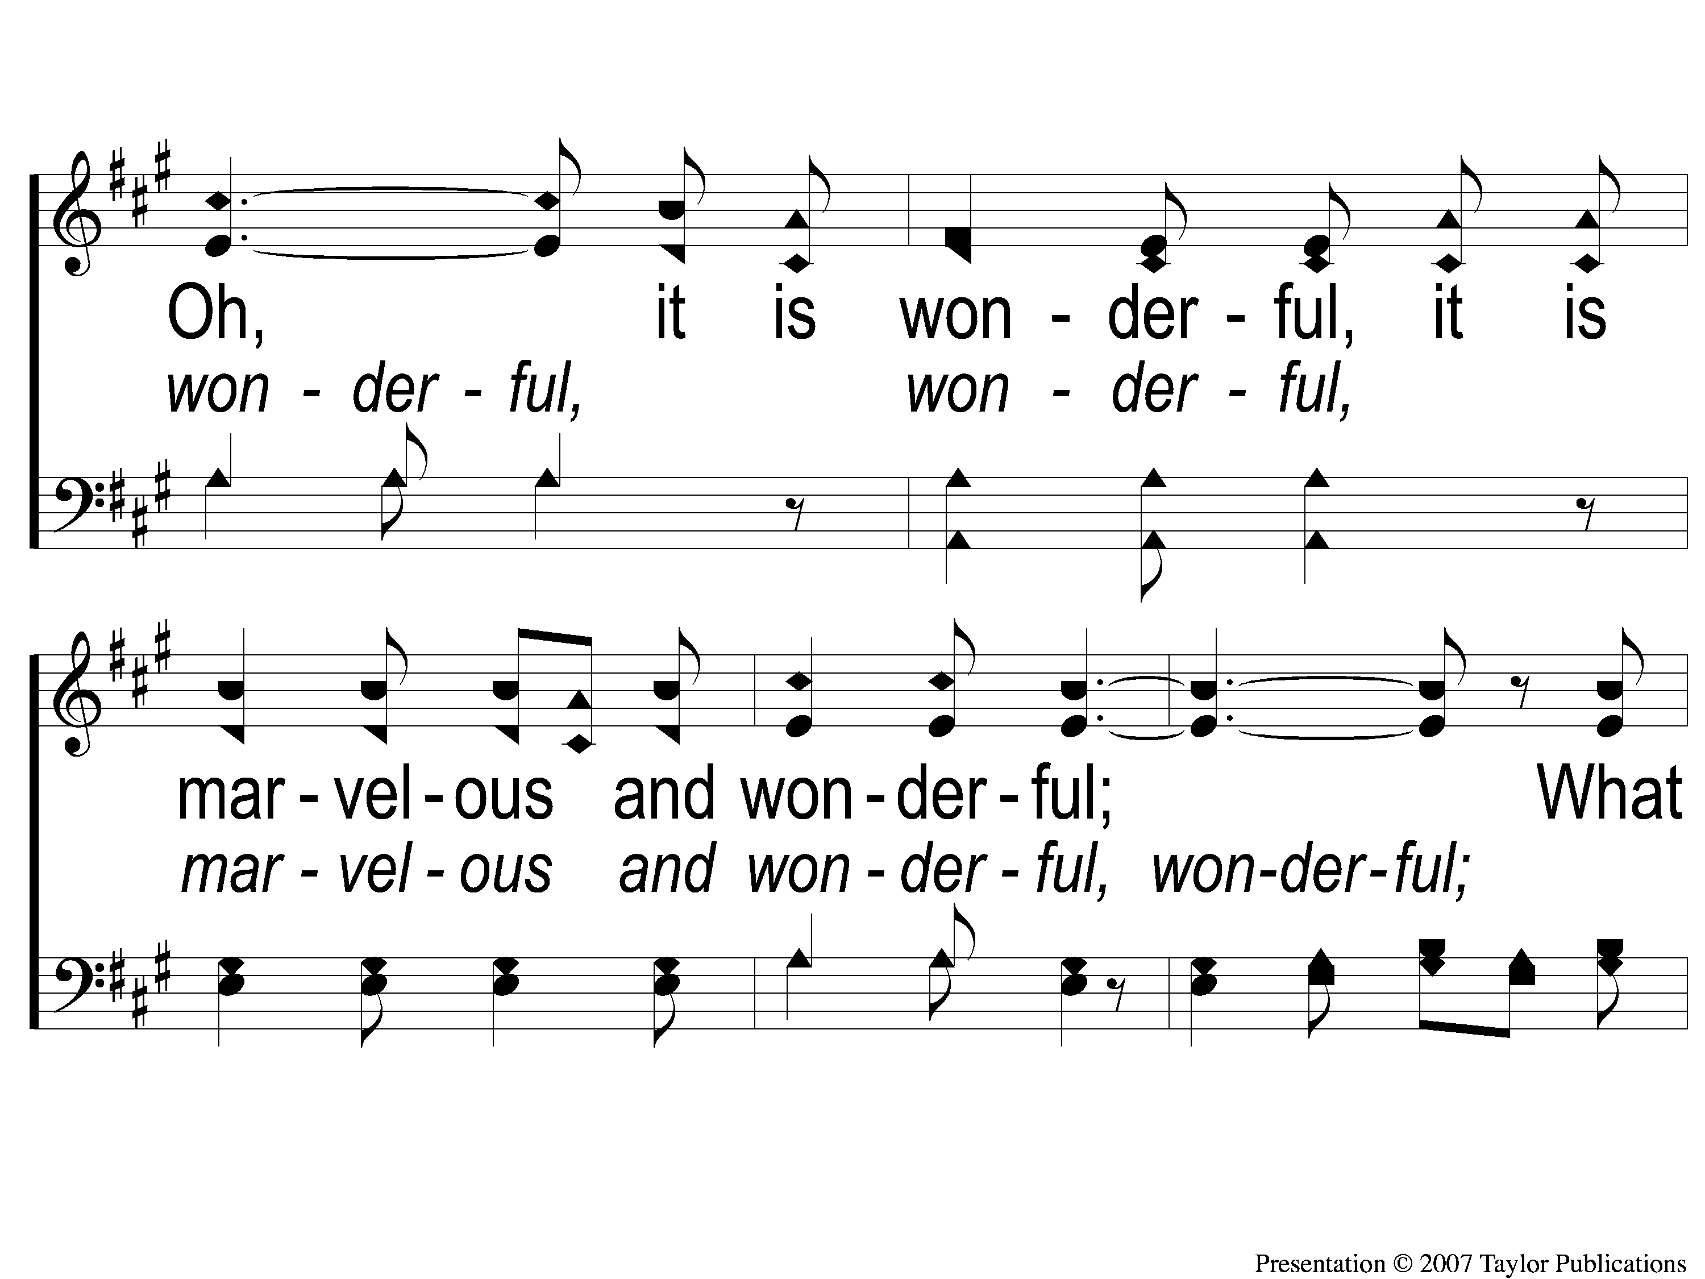
C-3 Tis Marvelous
Tis Marvelous
160

Slide 6
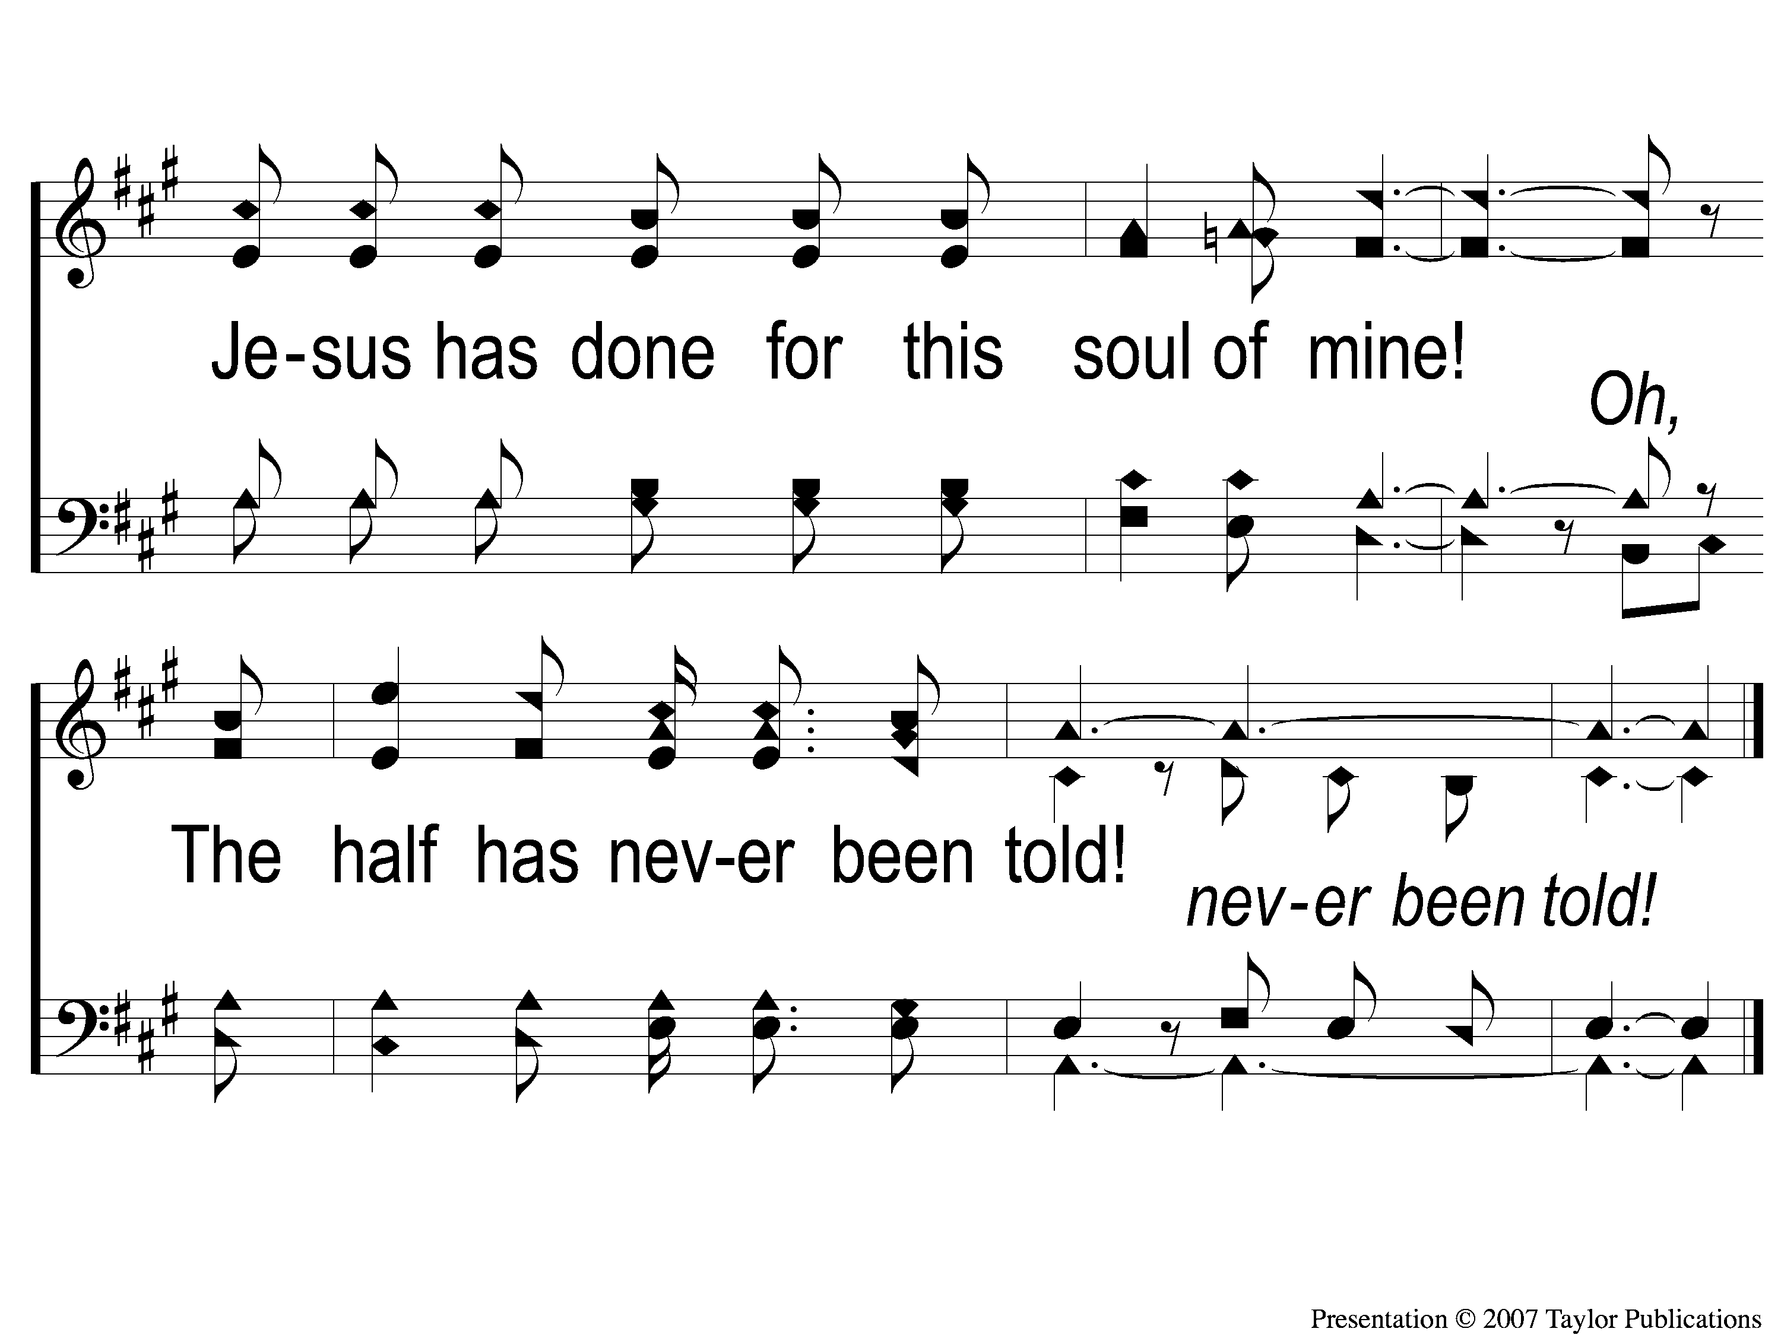
C-4 Tis Marvelous
Tis Marvelous
160

Slide 7
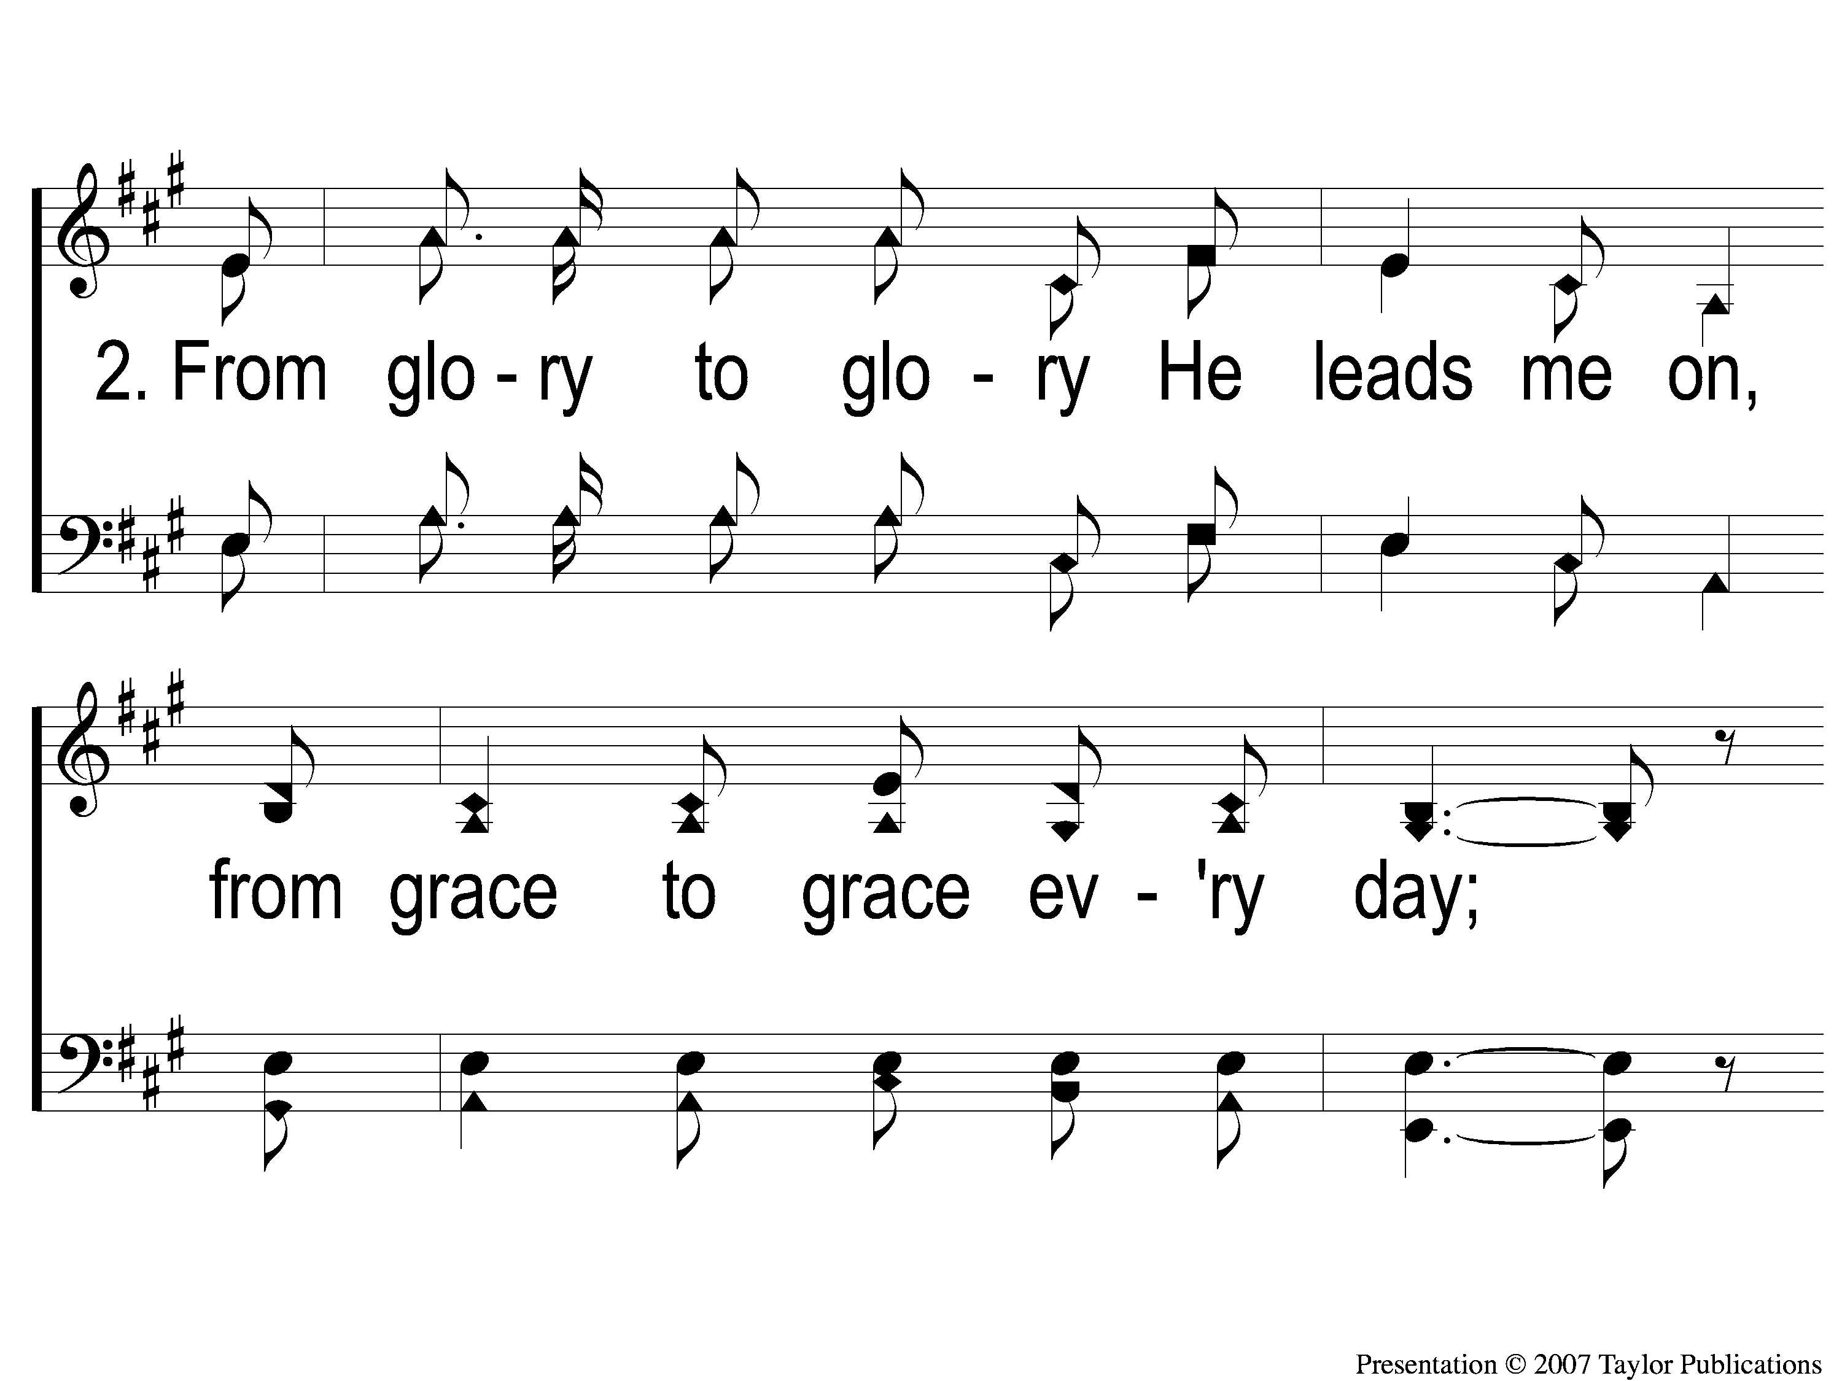
2-1 Tis Marvelous
Tis Marvelous
160

Slide 8
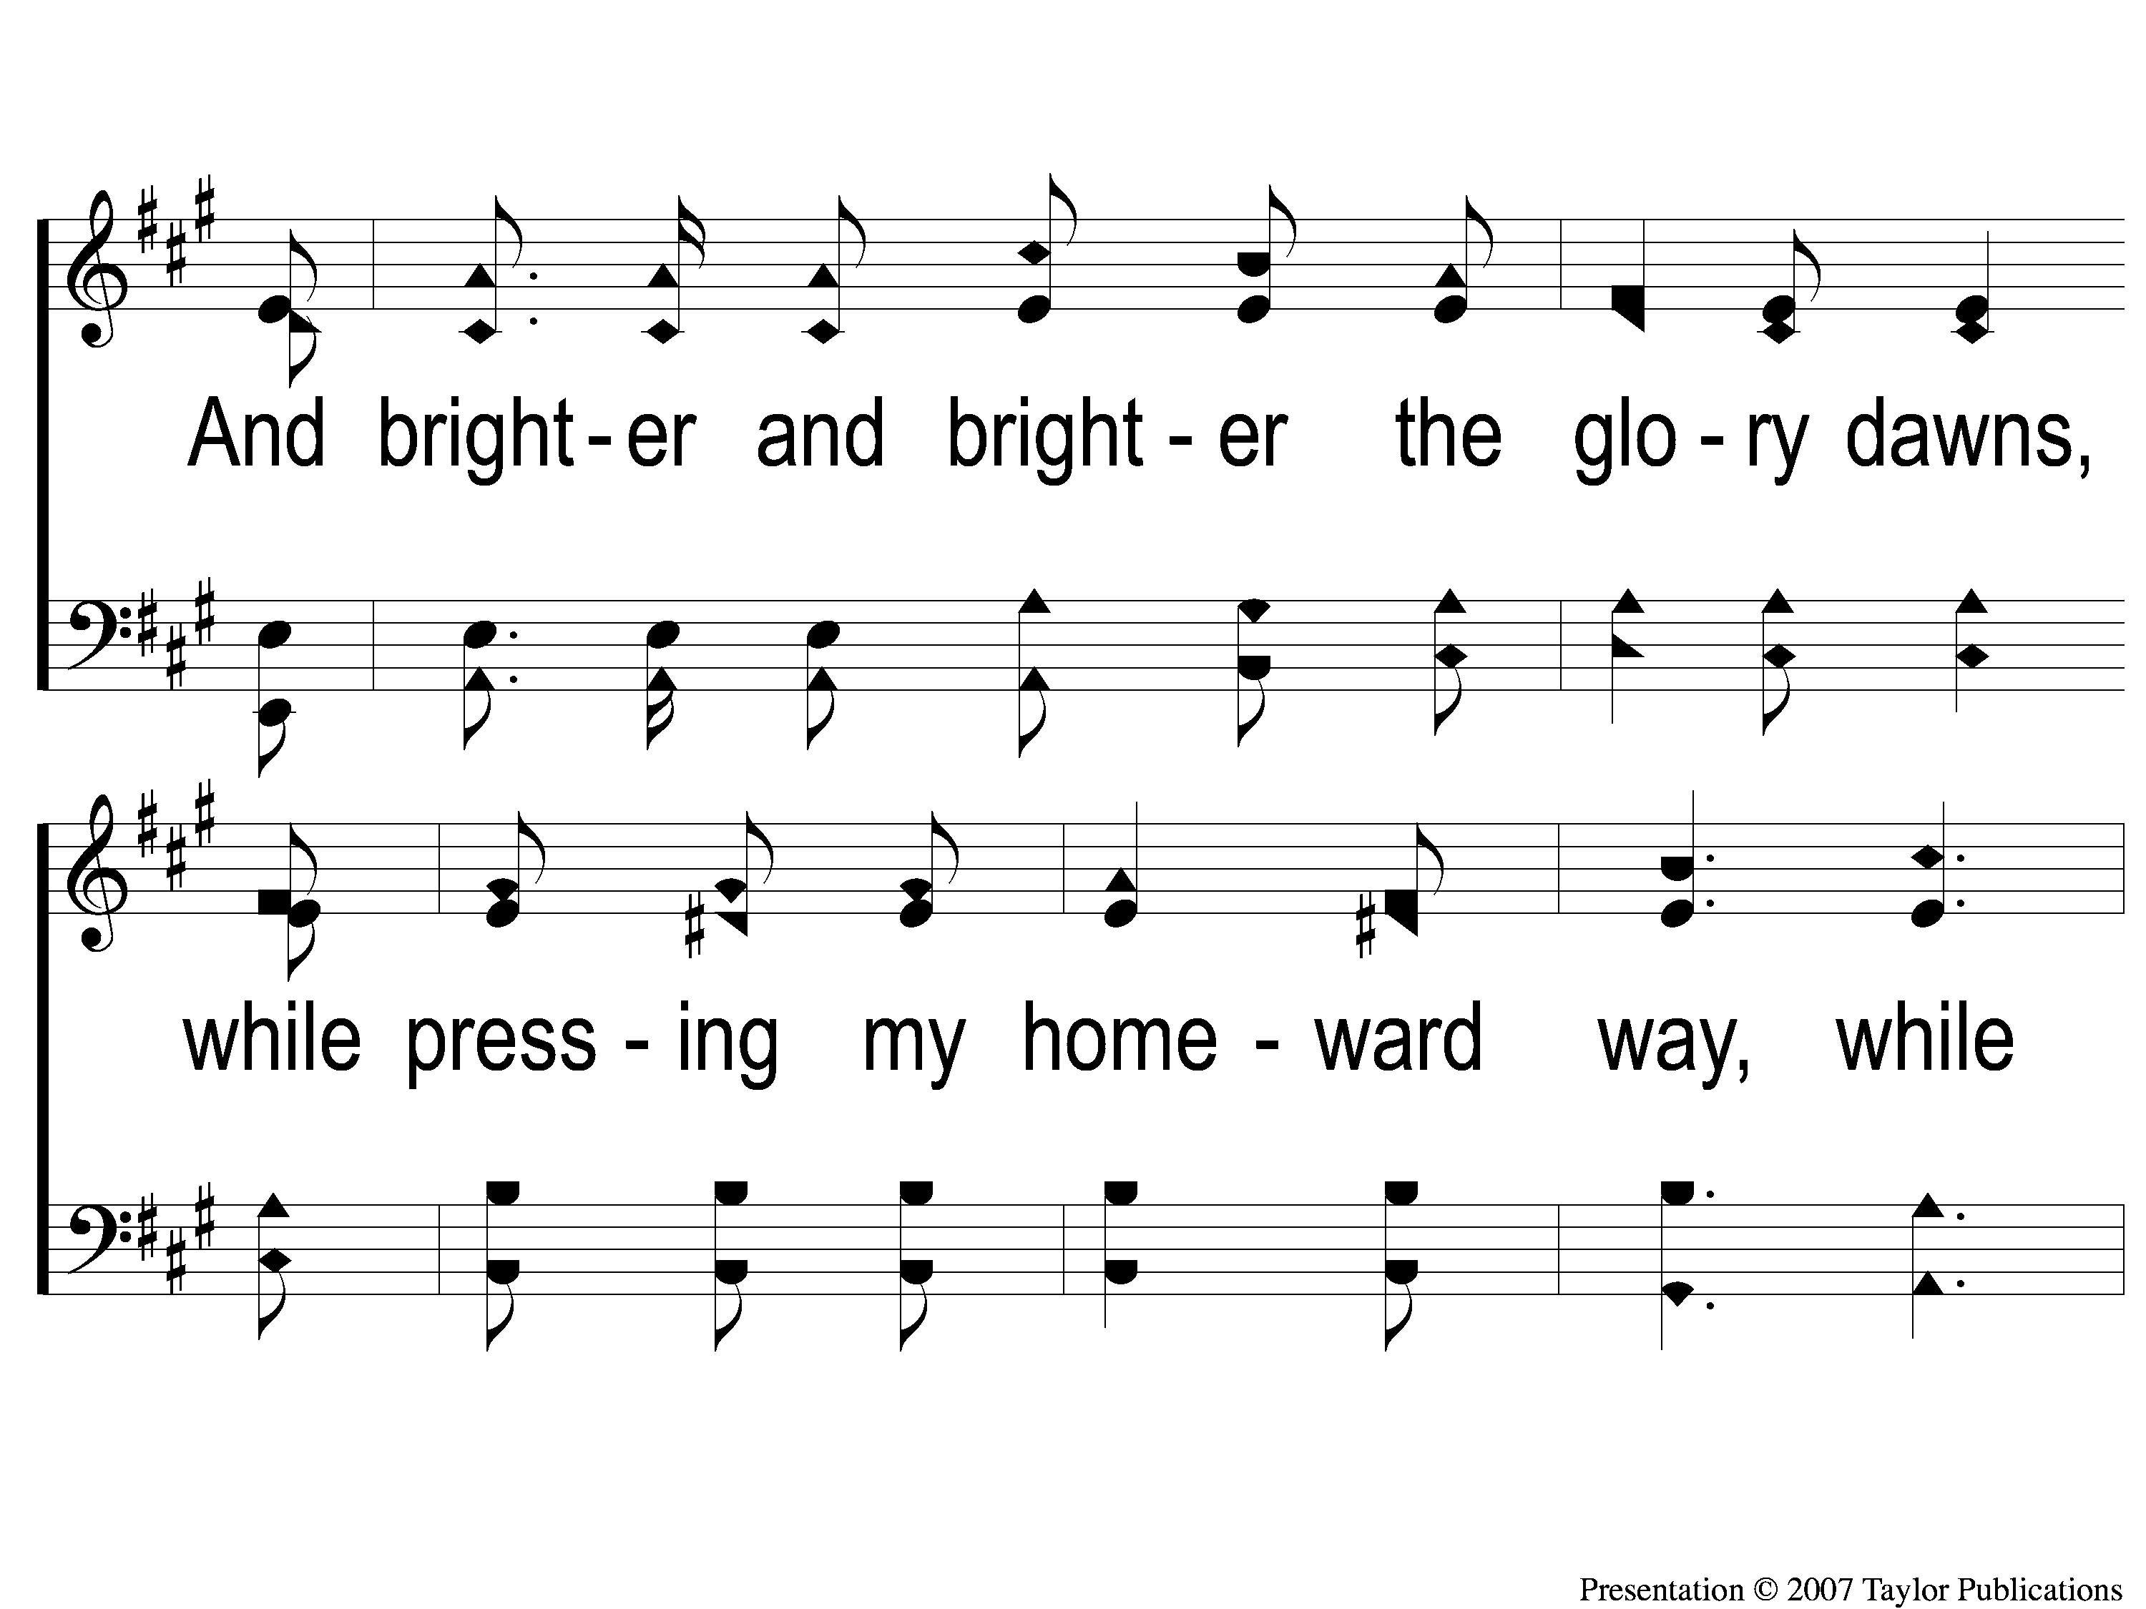
2-2 Tis Marvelous
Tis Marvelous
160

Slide 9
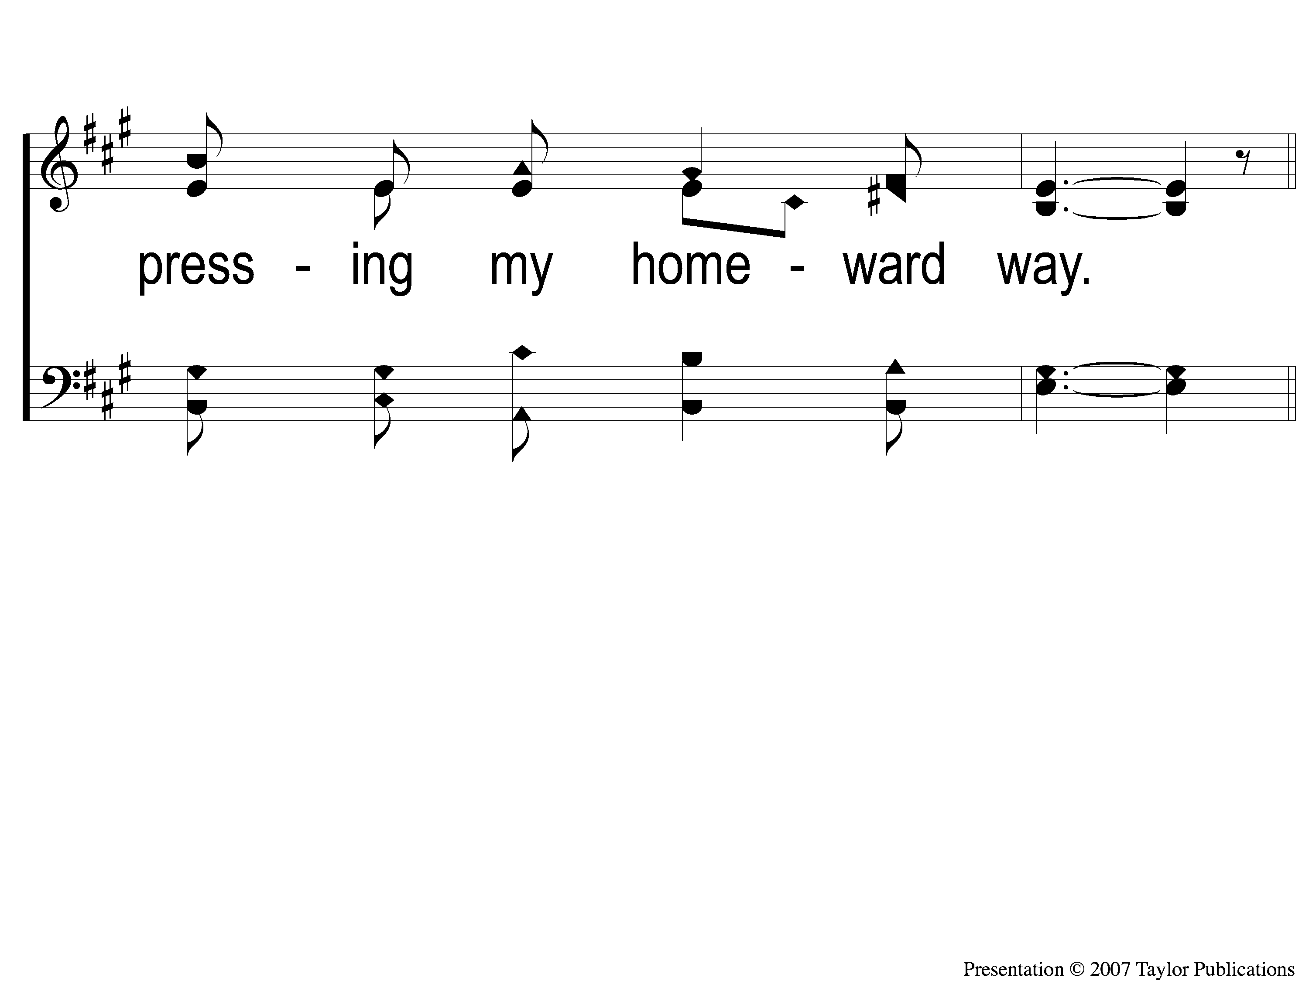
2-3 Tis Marvelous
Tis Marvelous
160

Slide 10
C-1 Tis Marvelous
Tis Marvelous
160

Slide 11
C-2 Tis Marvelous
Tis Marvelous
160

Slide 12
C-3 Tis Marvelous
Tis Marvelous
160

Slide 13
C-4 Tis Marvelous
Tis Marvelous
160

Slide 14
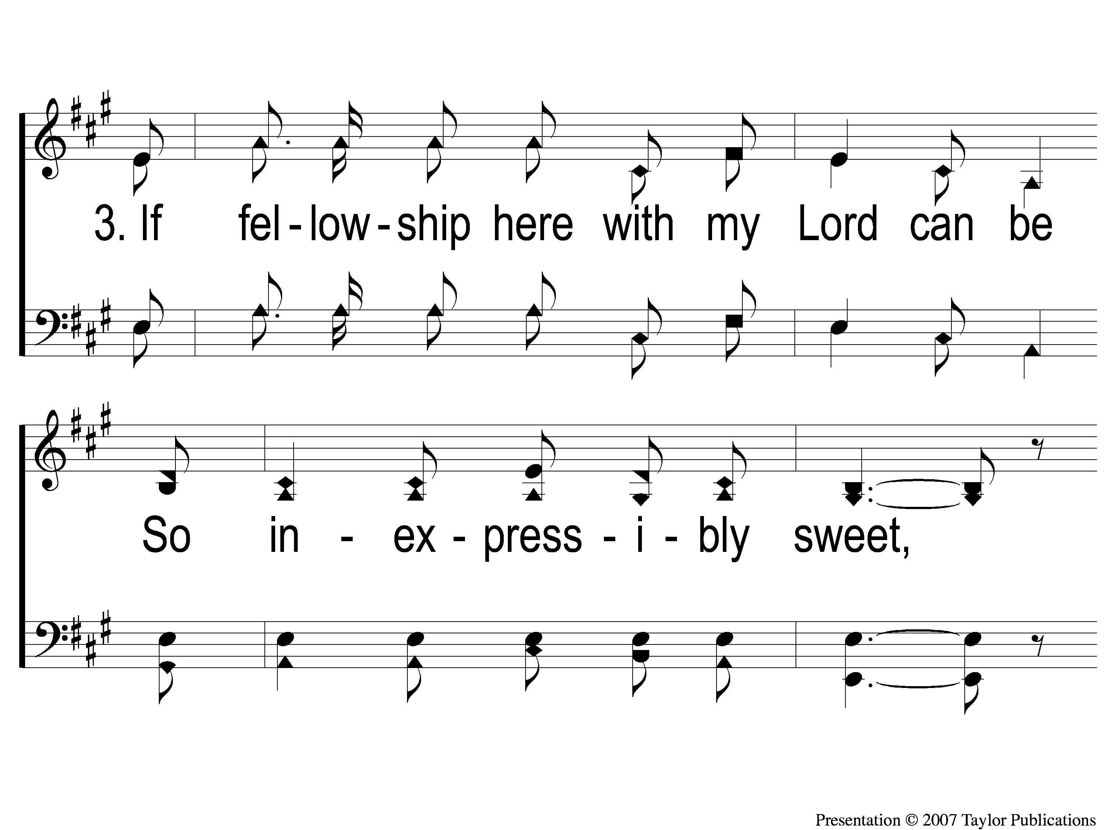
3-1 Tis Marvelous
Tis Marvelous
160

Slide 15
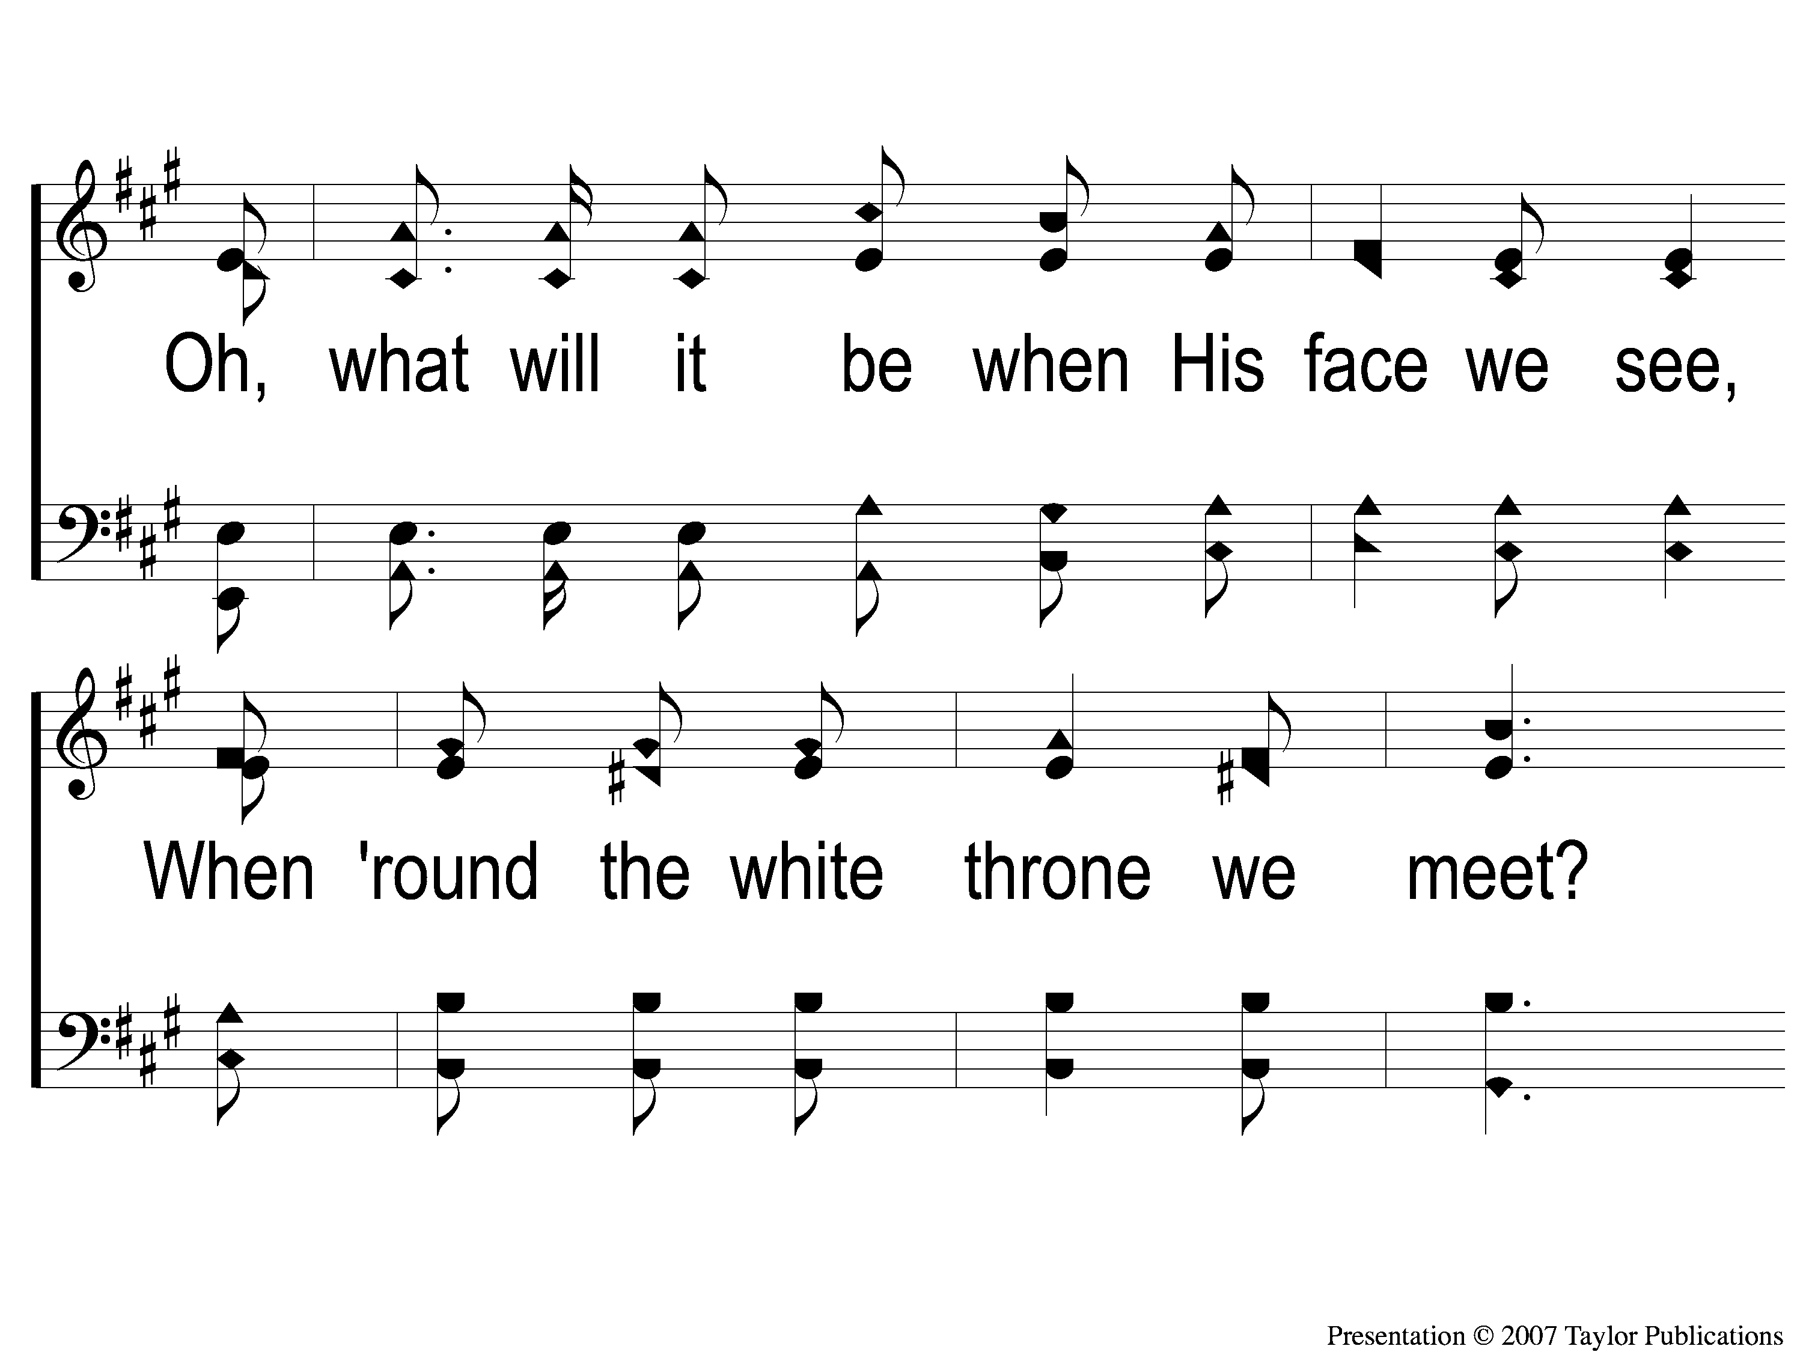
3-2 Tis Marvelous
Tis Marvelous
160

Slide 16
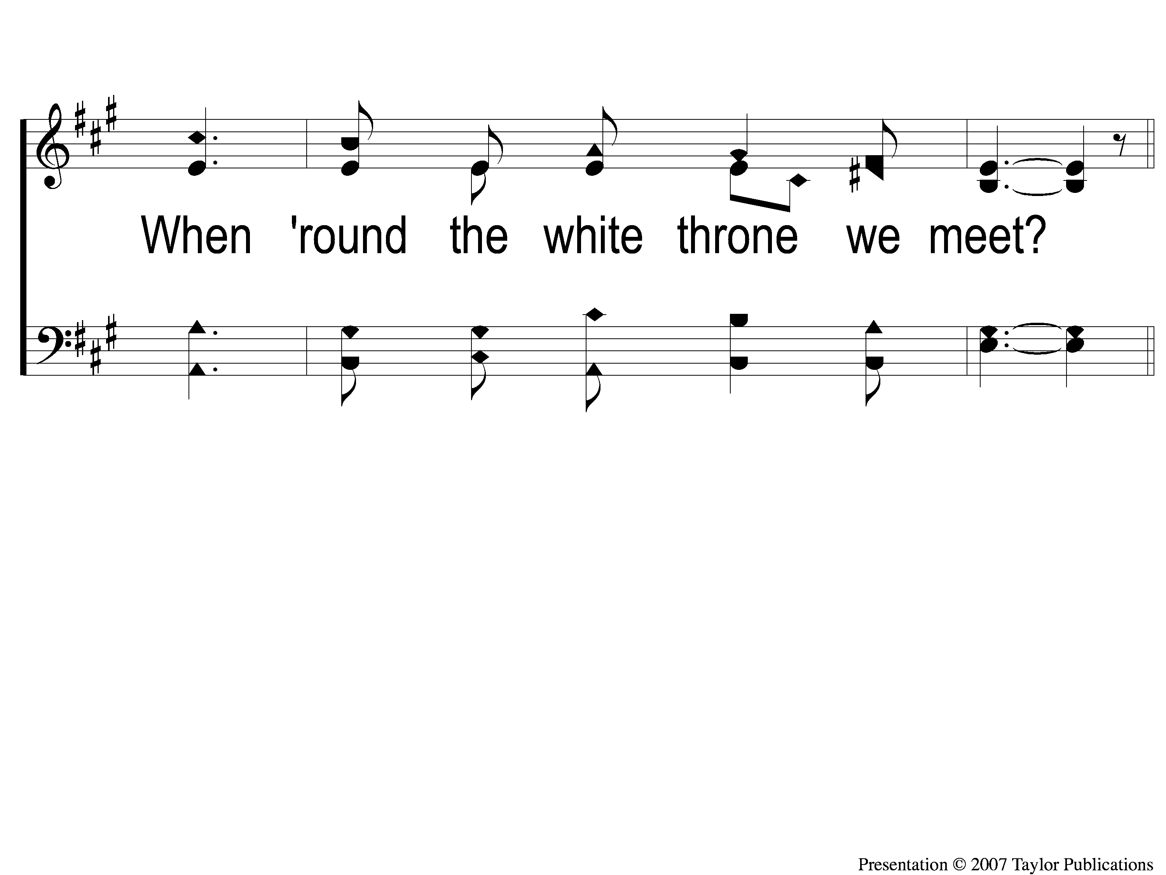
3-3 Tis Marvelous
Tis Marvelous
160

Slide 17
C-1 Tis Marvelous
Tis Marvelous
160

Slide 18
C-2 Tis Marvelous
Tis Marvelous
160

Slide 19
C-3 Tis Marvelous
Tis Marvelous
160

Slide 20
C-4 Tis Marvelous
Tis Marvelous
160

